Slide 1
Azure SQL Data Warehouse
L300 deck
Matt Goswell (matgos@microsoft.com)
James Rowland-Jones (jrj@microsoft.com)
Dec2016

Slide 2
Contents
In presentation mode click on any box to jump to that section
Introduction
Use case, pattern and adoption
Architectural overview
Scale operations
Tables & distribution
Scenarios
Client connectivity
Sizing & storage tiers
Concurrency
Loading
DWU
Differentiating technical capabilities
Developing with SQL DW
Migration
Partner ecosystem
Resources \ CTA

Slide 3
Introduction

Slide 4


Where does a data warehouse fit? Everywhere!
Data & service architecture
Govern
Secure
Monitor
Active Directory
Op / App Insights
Ops
Data Catalog
Ingest
Store
Interact
Mkt
SQL
Data Lake Store
Data Factory
HDI / ADLA
Data Warehouse
PowerBI
App Svcs
Sales
Analyze
Analyst
ML / R / CS / Spark
Scientist

Slide 5
Changes in Enterprise Data Warehouse space
Organizations are changing with increasing demand to:
Integrate with new or unstructured data
Drive to the cloud
Reduce or remove hardware renewal
Reduction in support costs
SQL

Slide 6



Introducing Azure SQL Data Warehouse
A relational data warehouse-as-a-service, fully managed by Microsoft.
Industries first elastic cloud data warehouse with proven SQL Server capabilities.
Support your smallest to your largest data storage needs.
Elastic scale & performance
Market Leading Price & Performance
Powered by the Cloud
Azure
Azure
Get started in minutes
Integrated with Azure ML, PowerBI & ADF
Scales to petabytes of data
Massively Parallel Processing
Instant-on compute scales in seconds
Query Relational / Non-Relational
Saas
Simple billing compute & storage
Pay for what you need, when you need it with dynamic pause
Azure
Office 365
Office 365
Public
Cloud
Notes:
THREE pillars of the service:
Elastic scale & performance
Separating compute and storage forces a focus on compute as a premium and storage as a commodity
Separating compute enables near – instant movement from one compute size to another with little to no impact to customers
Storage can scale to PB+ easily with proven Azure Storage as the backing system
Separate compute allows for cloud scenarios such as service pausing with minimal cost (storage only at commodity rates). This fulfills the premise of the cloud as a source of massive compute infrastructure. Premium possibilities include add on SLA for restarts ($$$) and AI based scaling for workloads based on historical usage data (e.g., learned system scalability and pausing based on optimal configurations such as need for data, past usage, expected usage – like a pause for weekends).
Market-leading price/performance
Moving the conversation away from nodes and disks and to storage and compute as a way to provide insight. Customers don’t care that a DW has x spindles and x cores – they really just want insights into their data. Amazon targets disks and storage without a way for the customer to see how fast they can get an answer from their data.
SQL DW will target Amazon Redshift as a price competitor and will provide on par or better performance for a matched price.
As a key differentiator, Amazon requires that you decide what system you’d like up front (dense compute or dense storage). Separating the two means that as a customer, I can decide how much data vs. compute to use and adjust over time and then simply be billed for what I use. This differentiates the service as Amazon requires you to ‘buy/reserve’ nodes and storage whether you use the capacity or note. One is a cost calculation (optimizing for usage of data center resources) and the other is customer centric – focusing on what the customer gets and pays for the service with the same or better performance.
True SQL Server experience
SQL Server 2014 based MPP architecture with a control node and n compute nodes that has been proven via 4+ years in the appliance market serving regional customers (Dixons, DenizBank, Helmerich & Payne), to mid-sized companies (T-Mobile, Progressive, Tangerine/ING, LG), to Forbes 100 corporations (Walmart, Johnson & Johnson, Comcast, Metlife)
TSQL language surface to simplify workload migrations from SQL Server SMP and SQL DB customers to the service minimizing conversion costs – means a large addressable market (SQL SMP data warehouse is estimated at 220k units with multiple workloads per unit)
Extends the SQL Server brand into the largest DW scenarios without rewrites (premium version of the SMP box and cloud services)
Launching with a targeted 60 ISV partners (Tableau, Informatica, Revolution Analtyics, SAP, MicroStrategy, Attunity, Tibco and others) covering data loading, BI and reporting, and analytics (including predictive)
Query across all data types and all locations
The service will integrate with key first party Azure offerings such as PowerBI, AzureML and Azure Data Factory to provide a model for exposing and aggregating data to customers through a full experience (data ingestion, aggregation, analytics and reporting).
Polybase as an integration technology enables the surfacing of data from Hadoop (Horton Data Platform 1.x/2.x, Cloudera 4.x/5.x, HDInsight) and Azure Storage as a remote table in the service.
Using both Map Reduce/YARN query engines as well as internal SQL Server query optimization, Polybase is able to efficiently determine how and where to query the data (either a push down query or streaming data back to SQL dw)
This enables all kinds of hybrid scenarios such as structured (say POS and inventory data) and unstructured data (web logs, social media sentiment analysis) into a single world with the SQL DW service as a hub to all data insights

Slide 7
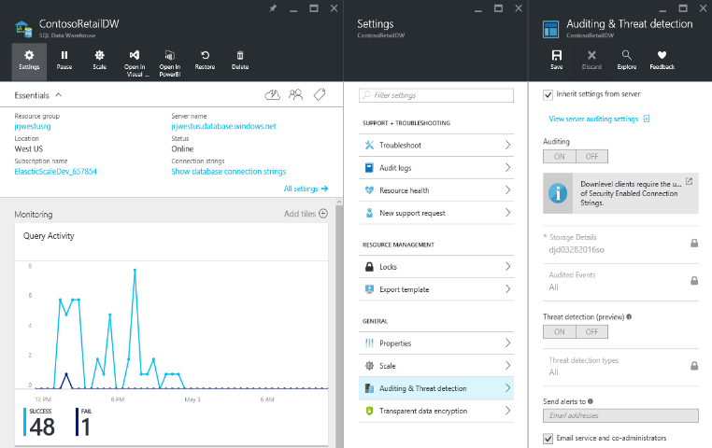
A fully managed Platform-as-a-Service
Azure cloud data warehouse service
Elastic scale
Separate storage and compute
Use existing tools and skills
Deploy and use in minutes!
Notes:
Fully managed

Slide 8
Integrates with existing processes
Analysis Services (ROLAP)
SQL Server
Data sources
Relational
Non-Relational
SSIS
Polybase
BCP
ADF
Event Hubs
Stream Analytics
Hadoop
Azure Blob Storage
Azure Machine Learning
Stream Analytics
PaaS
IaaS
Analysis
Services (MOLAP)
Azure SQL Data Warehouse

Slide 9
Supports data ingestion from literally anywhere…
Azure
Data Factory
Data/ Workload
IaaS
PaaS
Analysis
Services (MOLAP)
Azure SQL Data Warehouse
Other Azure components
Hadoop
Azure Blob Storage
Azure Machine Learning

Slide 10
Technical capabilities
SQL data warehouse: An elastic solution
Industry’s first enterprise-class cloud data warehouse that can grow, shrink, and pause in seconds
Petabyte scalability with massive parallel processing
Full enterprise-class SQL Server experience
Independent scale of compute and storage in seconds
Seamless compatibility with Power BI, Azure Machine Learning, HDInsight, and Azure Data Factory
Transaction of SQL queries across relational and non-relational data in Hadoop with PolyBase
Notes:
Fortunately, there’s Microsoft Azure SQL Data Warehouse.
[Click]
It is the industry’s first enterprise-class cloud data warehouse that can grow, shrink, and pause in seconds.
[Click]
It enables scaling with the HDInsight Hadoop service on Microsoft Azure. Based on the proven SQL Server relational database engine, it includes the features you expect from an enterprise data warehouse, including stored procedures, user-defined functions, table partitioning, indexes, and collations.
[Click]
SQL Data Warehouse works seamlessly with Power BI, Azure Machine Learning, HDInsight, and Azure Data Factory.
[Click]
It gives petabyte scalability with massive parallel-processing architecture that enables distributed processing to handle the rigors of modern data realities.
[Click]
It independently scales compute and storage in seconds.
[Click]
And importantly, Microsoft PolyBase provides the ability to query relational and non-relational data in Hadoop with a single, T-SQL-based query model that can support both relational and non-relational data in parallel.

Slide 11
The Microsoft Data Platform delivers everywhere
BI AND ANALYTICS
Self-service
Corporate
Collaboration
Mobile
Predictive
DATA ENRICHMENT AND FEDERATED QUERY
Single query model
Extract, transform, load
Data quality
Master data management
DATA MANAGEMENT AND PROCESSING
Relational
Non-relational
Analytical
Streaming
Internal & external
Notes:
Azure SQL Data Warehouse includes a complete suite of fully supported solutions and technologies that can meet the needs of even the most sophisticated and demanding modern enterprise.
As illustrated here, these solutions and technologies include BI and analytics, data enrichment and federated query, data management and processing, and infrastructure.

Slide 12





Cortana Intelligence Suite includes SQL DW
Transform data into intelligent action
Information Management
Big Data Stores
Machine Learning and Analytics
Dashboards and Visualizations
Business apps
Azure
Machine Learning
Power BI
Azure
Data Factory
Azure
Data Lake
Personal Digital Assistant
Azure
HDInsight (Hadoop)
Cortana
People
Azure
Data Catalog
Azure
SQL Data Warehouse
Perceptual Intelligence
Custom apps
Azure
Stream Analytics
Face, vision
Azure
Data Lake Analytics
Speech, text
Azure
Event Hub
Business Scenarios
Sensors and devices
Recommendations,
customer churn,
forecasting, etc.
Automated Systems
DATA
INTELLIGENCE
ACTION
Notes:
Cortana Analytics Suite delivers an end-to-end platform with integrated and comprehensive set of tools and services to help you build intelligent applications that let you easily take advantage of Advanced Analytics.
First Cortana Analytics Suite provides services to bring data in, so that you can analyze it. It provides information management capabilities like Azure Data Factory so that you can pull data from any source (relational DB like SQL or non-relational ones like your Hadoop cluster) in an automated and scheduled way, while performing the necessary data transforms (like setting certain data colums as dates vs. currency etc). Think ETL (Extract, Transform, Load) in the cloud. Event hub does the same for IoT type ingestion of data that streams in from lots of end points.
The data brought in then can be persisted in flexible big data storage services like Data Lake and Azure SQL DW.
You can then use a wide range of analytics services from Azure ML to Azure HDInsight to Azure Stream Analytics to analyze the data that are stored in the big data storage. This means you can create analytics services and models specific to your business need (say real time demand forecasting).
The resultant analytics services and models created by taking these steps can then be surfaced as interactive dashboards and visualizations via Power BI
These same analytics services and models created can also be integrated into various different UI (web apps or mobile apps or rich client apps) as well as via integrations with Cortana, so end users can naturally interact with them via speech etc., and so that end users can get proactively be notified by Cortana if the analytics model finds a new anomaly (unusual growth in certain product purchases- in the case of real time demand forecasting example given above) or whatever deserves the attention of the business users.

Slide 13
Use case, patterns and adoption

Slide 14
SQL DW is good for analytical workloads. Why?
Store large volumes of data.
Consolidate disparate data into a single location.
Shape, model, transform and aggregate data.
Perform query analysis across large datasets.
Ad-hoc reporting across large data volumes.
All using simple SQL constructs.
“SQL on SQL”
Notes:
Petabyte scale

Slide 15




Unsuitable workloads for SQL DW
Operational workloads (OLTP)
High frequency reads and writes.
Large numbers of singleton selects.
High volumes of single row inserts.
Data Preparation
Row by row processing needs.
Incompatible formats (JSON, XML).

Slide 16
Pattern
Big Data Warehouse
Unknown Value Data
XML
High Value Data
JSON
SQL
TEXT
Preparation
Pre-process
Transpose
Re-format
Model
Load
Transform
Aggregate
Consume
Batch
Ad-hoc
Batch

Slide 17
Pattern
ELASTIC consumption
Persist
Export
Query
SQL
SQL
VM
Stream
Import
Import
Resume
Ingest
Aggregate
Export
Pause
Lower Cost
High Concurrency
“Dashboard Query”
Notes:
Red Stars
Archive on the way in to the warehouse
Geo-redundant blob storage guarantees your data
Allows for RPO 0 Data Warehouse architectures
Allows for point in time restart-ability of ELT
Resume / Pause Pattern

Slide 18
Pattern
Fixed period analysis
SQL
SQL
VM
Clickstream
SQL
Notes:
Red Stars
Consistent single view of raw data held in Blob Storage accessible by all consumers of data
Customer specific DWU settings allowing for simple chargeback models

Slide 19
Pattern
Chargeback
DWU 200
SQL
DWU 600
SQL
Customer
VM
Clickstream
Corporate
DWU 1200
SQL
Notes:
Red Stars
Consistent single view of raw data held in Blob Storage accessible by all consumers of data
Customer specific DWU settings allowing for simple chargeback models

Slide 20
Scenarios

Slide 21


Azure Data Lake and Azure SQL Data Warehouse
Modern Data Warehouse
Unknown Value Data
XML
High Value Data
JSON
TEXT
Model
Load
Transform
Aggregate
Consume
Preparation
Pre-process
Transpose
Re-format
Batch
Ad-hoc
Batch

Slide 22



Pattern: Compute consumption
Persist
Export
Query
Stream
Import
Import
Resume
Ingest
Aggregate
Export
Pause
Lower Cost
High Concurrency
“Dashboard Query”
Notes:
Red Stars
Archive on the way in to the warehouse
Geo-redundant blob storage guarantees your data
Allows for RPO 0 Data Warehouse architectures
Allows for point in time restart-ability of ELT
Resume / Pause Pattern

Slide 23

Pattern: SaaS customer isolation
DWU 200
DWU 600
Customer
Clickstream
Corporate
DWU 1200
Notes:
Red Stars
Consistent single view of raw data held in Blob Storage accessible by all consumers of data
Customer specific DWU settings allowing for simple chargeback models

Slide 24
Architectural overview

Slide 25
Azure SQL Data Warehouse Architecture
Application or User connection
Storage and Compute are de-coupled, enabling a true elastic service and separate charging for both compute and storage
DMS (Data Movement Service) executes across all database nodes
Data Loading
(SSIS, REST, OLE, ADO, ODBC, WebHDFS, AZCopy, PS)
Control
Node
DMS
Massively Parallel Processing (MPP) Engine
100 DWU < > 6000 DWU
Compute
Scale compute up or down when required
Pause, Resume, Stop, Start.
DMS
DMS
DMS
DMS
SQL DB
SQL DB
SQL DB
SQL DB
Compute
Node
Compute
Node
Compute
Node
Compute
Node
Azure Infrastructure and Storage
Azure Premium Storage
Storage
Add\Load data to WASB(S) without incurring compute costs

Slide 26
Azure SQL Data Warehouse – Control Node
SQL DB
SQL DB
Control
Node
Massively Parallel Processing (MPP) Engine
Control
Node
SQL DB
SQL DB
SQL DB
SQL DB
Compute
Node
Compute
Node
Compute
Node
Compute
Node
Endpoint for connections
Regular SQL endpoint (TCP 1433)
Persists no user data (metadata only)
Coordinates compute activity using MPP
Azure Premium Storage

Slide 27
Azure SQL Data Warehouse - Compute Nodes
SQL DB
SQL DB
Control
Node
Massively Parallel Processing (MPP) Engine
Compute
Node(s)
SQL DB
SQL DB
SQL DB
SQL DB
Compute
Node
Compute
Node
Compute
Node
Compute
Node
Azure SQL Database
An increase of DWU will increase the number of compute nodes
Azure Premium Storage

Slide 28
Azure SQL Data Warehouse – Blob storage
SQL DB
Control
Node
Massively Parallel Processing (MPP) Engine
SQL DB
SQL DB
SQL DB
SQL DB
RA-GRS storage
+PB’s of storage
When compute is paused it is still possible to ingest data into blob storage without incurring compute costs
Compute
Node
Compute
Node
Compute
Node
Compute
Node
Azure Premium Storage

Slide 29

Logical overview
Control
Compute
Storage
Notes:
De-coupled storage from compute & control
Completely elastic
Pay for the data you store and the compute you provision

Slide 30
Scale operations

Slide 31
Mapping Compute in SQLDW
DW100
01
02
03
04
05
06
07
08
09
10
11
12
13
14
15
16
17
18
19
20
21
22
23
24
25
26
27
28
29
30
31
32
33
34
35
36
37
38
39
40
41
42
43
44
45
46
47
48
49
50
51
52
53
54
55
56
57
58
59
60

Slide 32
Mapping Compute in SQLDW
DW200
01
02
03
04
05
06
07
08
09
10
11
12
13
14
15
16
17
18
19
20
21
22
23
24
25
26
27
28
29
30
31
32
33
34
35
36
37
38
39
40
41
42
43
44
45
46
47
48
49
50
51
52
53
54
55
56
57
58
59
60

Slide 33
Mapping Compute in SQLDW
DW300
01
02
03
04
05
06
07
08
09
10
11
12
13
14
15
16
17
18
19
20
21
22
23
24
25
26
27
28
29
30
31
32
33
34
35
36
37
38
39
40
41
42
43
44
45
46
47
48
49
50
51
52
53
54
55
56
57
58
59
60

Slide 34
Mapping Compute in SQLDW
DW400
01
02
03
04
05
06
07
08
09
10
11
12
13
14
15
16
17
18
19
20
21
22
23
24
25
26
27
28
29
30
31
32
33
34
35
36
37
38
39
40
41
42
43
44
45
46
47
48
49
50
51
52
53
54
55
56
57
58
59
60

Slide 35
Mapping Compute in SQLDW
DW500
01
02
03
04
05
06
07
08
09
10
11
12
13
14
15
16
17
18
19
20
21
22
23
24
25
26
27
28
29
30
31
32
33
34
35
36
37
38
39
40
41
42
43
44
45
46
47
48
49
50
51
52
53
54
55
56
57
58
59
60

Slide 36
Pausing compute in SQLDW
DW500
01
02
03
04
05
06
07
08
09
10
11
12
13
14
15
16
17
18
19
20
21
22
23
24
25
26
27
28
29
30
31
32
33
34
35
36
37
38
39
40
41
42
43
44
45
46
47
48
49
50
51
52
53
54
55
56
57
58
59
60

Slide 37
Resuming compute in SQLDW
DW500
01
02
03
04
05
06
07
08
09
10
11
12
13
14
15
16
17
18
19
20
21
22
23
24
25
26
27
28
29
30
31
32
33
34
35
36
37
38
39
40
41
42
43
44
45
46
47
48
49
50
51
52
53
54
55
56
57
58
59
60

Slide 38
Tables & Distribution

Slide 39
Distributed queries
Query
Result
Control
Compute
Storage
Notes:
Scale-out distributed query engine

Slide 40
Simple example
SELECT COUNT_BIG(*)
FROM dbo.[FactInternetSales]
;
SELECT SUM(*)
FROM dbo.[FactInternetSales]
;
Control
Compute
SELECT COUNT_BIG(*)
FROM dbo.[FactInternetSales]
;
SELECT COUNT_BIG(*)
FROM dbo.[FactInternetSales]
;
SELECT COUNT_BIG(*)
FROM dbo.[FactInternetSales]
;
SELECT COUNT_BIG(*)
FROM dbo.[FactInternetSales]
;

Slide 41
Creating tables
CREATE TABLE [build].[FactOnlineSales]
(
[OnlineSalesKey] int NOT NULL
, [DateKey] datetime NOT NULL
, [StoreKey] int NOT NULL
, [ProductKey] int NOT NULL
, [PromotionKey] int NOT NULL
, [CurrencyKey] int NOT NULL
, [CustomerKey] int NOT NULL
, [SalesOrderNumber] nvarchar(20) NOT NULL
, [SalesOrderLineNumber] int NULL
, [SalesQuantity] int NOT NULL
, [SalesAmount] money NOT NULL
)
WITH
( CLUSTERED COLUMNSTORE INDEX
, DISTRIBUTION = ROUND_ROBIN
)
;
CREATE TABLE [build].[FactOnlineSales]
(
[OnlineSalesKey] int NOT NULL
, [DateKey] datetime NOT NULL
, [StoreKey] int NOT NULL
, [ProductKey] int NOT NULL
, [PromotionKey] int NOT NULL
, [CurrencyKey] int NOT NULL
, [CustomerKey] int NOT NULL
, [SalesOrderNumber] nvarchar(20) NOT NULL
, [SalesOrderLineNumber] int NULL
, [SalesQuantity] int NOT NULL
, [SalesAmount] money NOT NULL
)
WITH
( CLUSTERED COLUMNSTORE INDEX
, DISTRIBUTION = HASH([ProductKey])
)
;

Slide 42
ROUND ROBIN DISTRIBUTION
01
02
03
04
05
06
07
08
09
10
11
12
13
14
15
16
17
18
19
20
21
22
23
24
25
26
27
28
29
30
31
32
33
34
35
36
37
38
39
40
41
42
43
44
45
46
47
48
49
50
51
52
53
54
55
56
57
58
59
60

Slide 43
HASH distribution
HASH ( )
01
01
02
03
01
02
03
04
05
06
07
08
09
10
11
12
13
14
15
16
17
18
19
20
21
22
23
24
25
26
27
28
29
30
31
32
33
34
35
36
37
38
39
40
41
42
43
44
45
46
47
48
49
50
51
52
53
54
55
56
57
58
59
60
Notes:
Consider NULL

Slide 44
Joining HASH tables
Store_Sales HASH([ProductKey])
Web_Sales HASH([ProductKey])
Notes:
JOIN is on the TYPE
Must also be an equi-join

Slide 45
Joining HASH tables
Store_Sales HASH([ProductKey])
[ProductKey] INT NULL
Web_Sales HASH([ProductKey])
[ProductKey] INT NULL

Slide 46
Joining HASH tables
Store_Sales HASH([ProductKey])
[ProductKey] INT NULL
Web_Sales HASH([ProductKey])
[ProductKey] BIGINT NULL

Slide 47
Client connectivity

Slide 48
Single Gated Client
Compute Node
DMS
Bridge
Control Node
Compute Node
Client
DMS
DMS
Bridge
Compute Node
DMS
Bridge

Slide 49
Single Gated Client Parallelised
Compute Node
DMS
Bridge
Client
Control Node
Compute Node
Client
DMS
DMS
Bridge
Client
Compute Node
DMS
Bridge

Slide 50
Parallel Loading with PolyBase
Compute Node
Azure Storage Blob (ASB)
DMS
Bridge
Control Node
Compute Node
DMS
DMS
Bridge
Compute Node
DMS
Bridge

Slide 51
Connectivity options
Windows or Linux
ODBC
OLEDB
JDBC
ADO.NET
PHP
Notes:
Customers also using FreeTDS from Linux

Slide 52
Sizing & Storage tiers

Slide 53
Sizing factors
Database capacity
Tempdb
Concurrency & Memory
Load
Transaction size
Memory management
DWU

Slide 54
Starting point: Sizing by capacity
Recommended starting point
Flexibility to select any range of DWUs
>160 TBs
80-160 TBs
60-80 TBs
48-60 TBs
36-48 TBs
20-36 TBs
16-20 TBs
12-16 TBs
8-12 TBs
4-8 TBs
0-4 TBs
100
200
300
400
500
600
1000
1200
1500
2000
3000
6000

Slide 55
Starting point: Sizing by workload
Workload Priority | Name | DWU | Cores / Distributions per Node
 | DW100 | 100 | 6 / 60
 | DW200 | 200 | 12 / 30
 | DW300 | 300 | 18 / 20
 | DW400 | 400 | 24 / 15
 | DW500 | 500 | 30 / 12
 | DW600 | 600 | 36 /10
 | DW1000 | 1000 | 60 / 6
 | DW1200 | 1200 | 72 / 5
 | DW1500 | 1500 | 90 / 4
 | DW2000 | 2000 | 120 / 3
 | DW3000 | 3000 | 180 / 2
 | DW6000 | 6000 | 360 / 1
Example services and applications
Workload
Basic reporting &
low priority data loading
Azure Blob Storage
Azure Data Factory
Azure Data Catalog
Azure Analysis Services
Azure Machine Learning
Azure Stream Analytics
Power BI
SQL Server Integration Services
SQL Server Analysis Services
SQL Server Reporting Services
Third-party \ Partner
. . .
Light-Medium query workloads
minor data transformation
Medium data loading
Low priority analytics
Medium query workloads
Medium data transformation
Medium to high data loading
Heavy or Critical queries
including significant
data transformation and high priority data loads

Slide 56
Storage tiers
Local storage
Premium storage (remote)
Blob storage (remote and geo redundant)

Slide 57
Data locations
Billed to customer
Local
Premium
Blob
Tempdb
Data files
Geo-backup
Log files
Snapshots

Slide 58
Local Storage: Tempdb sizing
~399GB
per DW100

Slide 59
Premium Storage: Capacity limits
240TB
File capacity
5x
CCI compression
>1PB
Db capacity

Slide 60
Premium Storage: Database Size
Unallocated
Unused
Total DB Size
Index
Reserved
Space
Used
Space
Data
Log
Notes:
Reserved - total space allocated by objects in the database
data – total amount of space used by data
index_size – total amount of space used by indexes
unused – total amount reserved for objects, but not used
Unallocated - space in the database that has not been reserved for database objects.

Slide 61
Premium Storage: Unallocated Space
4TB
Unallocated
12TB
Unallocated
12TB
Reserved
16 TB
4TB
Reserved

Slide 62
Premium Storage: Snapshots
Frequency
Retention
4
hours
7
days
RPO : 8 Hours

Slide 63
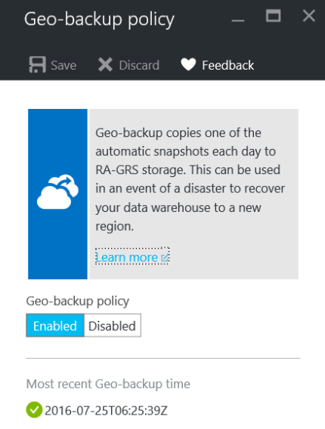
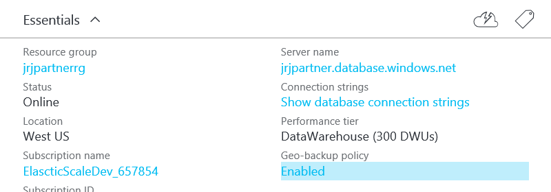
Blob Storage: Geo-redundant backups
Frequency and Retention
1
Geo-backup
24hr
RPO

Slide 64
Capping storage capacity
CREATE DATABASE MyDB COLLATE SQL_Latin1_General_CP1_CI_AS
(
EDITION = 'DataWarehouse'
, SERVICE_OBJECTIVE = 'DW400'
, MAXSIZE = 10240 GB
);
ALTER DATABASE MyDB
MODIFY (MAXSIZE = 245760 GB);
Notes:
You need to factor in the compression of the data so assuming 5x compression a 100TB db will hold 500TB data

Slide 65
Storage sizing summary
Database size:
sp_spaceused
Table sizing:
DMVs
Snapshot size:
Total storage size (portal) – database size (sp_spaceused)
Free space (unallocated):
sp_spaceused
Notes:
Use table sizing view…to query

Slide 66
Table sizing 1/2
WITH base AS
(
SELECT sm.[name] AS [schema_name]
, tb.[name] AS [table_name]
, nt.[distribution_id] AS [distribution_id]
, nt.[pdw_node_id] AS [node_id]
, nps.[partition_number] AS [partition_nmbr]
, nps.[reserved_page_count] AS [reserved_space_page_count]
, nps.[reserved_page_count] - nps.[used_page_count] AS [unused_space_page_count]
, nps.[in_row_data_page_count]
+ nps.[row_overflow_used_page_count] + nps.[lob_used_page_count] AS [data_space_page_count]
, nps.[reserved_page_count]
- (nps.[reserved_page_count] - nps.[used_page_count])
- ([in_row_data_page_count]+[row_overflow_used_page_count]+[lob_used_page_count]) AS [index_space_page_count]
,nps.[row_count] AS [row_count]
from sys.schemas sm
join sys.tables tb ON sm.[schema_id] = tb.[schema_id]
join sys.pdw_table_mappings tm ON tb.[object_id] = tm.[object_id]
join sys.pdw_nodes_tables nt ON tm.[physical_name] = nt.[name]
join sys.dm_pdw_nodes pn ON nt.[pdw_node_id] = pn.[pdw_node_id]
join sys.dm_pdw_nodes_db_partition_stats nps ON nt.[object_id] = nps.[object_id]
AND nt.[pdw_node_id] = nps.[pdw_node_id]
AND nt.[distribution_id] = nps.[distribution_id]
)

Slide 67
Table sizing 2/2
, size AS
(
SELECT
[schema_name]
, [table_name]
, [row_count]
, [distribution_id]
, [node_id]
, [partition_nmbr]
, ([reserved_space_page_count] * 8.0)/1048576 AS [reserved_space_GB]
, ([unused_space_page_count] * 8.0)/1048576 AS [unused_space_GB]
, ([data_space_page_count] * 8.0)/1048576 AS [data_space_GB]
, ([index_space_page_count] * 8.0)/1048576 AS [index_space_GB]
FROM [base]
)
SELECT *
FROM [size]
WHERE [schema_name] = 'cso'
AND [table_name] = 'FactOnlineSales'
;

Slide 68
Concurrency

Slide 69
Concurrency: queries
QID
QID
32
active queries
1024
open sessions
QID
QID
QID
QID

Slide 70
Concurrency: slots

Slide 71
Concurrency slot consumption
1
2-3
4-5

Slide 72
Concurrency impact: queries & slots

Slide 73
Est. mem grant example #1: 10 column table

Slide 74
Est. mem grant example #2: 30 column table

Slide 75
Memory grant sizing 1/2
DECLARE @rows INT = 102400;
WITH base AS
( SELECT table_name
, SUM(column_count) AS column_count
, ISNULL(SUM(short_string_count),0) AS short_string_count
, ISNULL(SUM(long_string_count),0) AS long_string_count
FROM ( SELECT tb.name AS table_name
, COUNT(co.column_id) AS column_count
, CASE WHEN co.system_type_id IN (167,175,231,239)
AND co.max_length <= 32
THEN COUNT(co.column_id)
END AS short_string_count
, CASE WHEN co.system_type_id IN (167,175,231,239)
AND co.max_length > 32
THEN COUNT(co.column_id)
END AS long_string_count
FROM sys.tables AS tb
JOIN sys.columns AS co ON tb.[object_id] = co.[object_id]
GROUP BY tb.name
, co.system_type_id
, co.max_length
) a
GROUP BY table_name
)

Slide 76
Memory grant sizing 2/2
, size AS
(
SELECT table_name
, 75497472 AS table_overhead
, column_count*@rows*8 AS column_size
, short_string_count*@rows*32 AS short_string_size
, (long_string_count*16777216)-(32*long_string_count) AS long_string_size
FROM base
)
SELECT table_name
, CAST((table_overhead*1.0+column_size+short_string_size+long_string_size)
AS DECIMAL(11,2)) AS est_mem_grant_B
, CAST((table_overhead*1.0+column_size+short_string_size+long_string_size)/1048576 AS DECIMAL(11,2)) AS est_mem_grant_MiB
, CAST((table_overhead*1.0+column_size+short_string_size+long_string_size)/1073741824 AS DECIMAL(11,2)) AS est_mem_grant_GiB
FROM size;

Slide 77
Transaction Size

Slide 78
Loading

Slide 79
Sizing for the data load
Delimited text guidance.
Evenly split the data into multiple files.
One file per reader.
Delimited text is the fastest.
DWU | Readers | Writers
DW100 | 8 | 60
DW200 | 16 | 60
DW300 | 24 | 60
DW400 | 32 | 60
DW500 | 40 | 60
DW600 | 48 | 60
DW1000 | 60 | 60
Compressed text limits concurrent access to text files
Split data across files
OR
Use different file format
Notes:
PolyBase
Azure Data Factory
SSIS
Bcp
3rd party data loading tools

Slide 80

Loading delimited text
A compressed text file cannot be read
in parallel
Splitting data across multiple files maximises load performance

Slide 81
Data loading
DWU | Max External Readers | Max Writers
DW100 | 8 | 60
DW200 | 16 | 60
DW300 | 24 | 60
DW400 | 32 | 60
DW500 | 40 | 60
DW600 | 48 | 60
DW1000 | 80 | 80
DW1200 | 96 | 96
DW1500 | 120 | 120
DW2000 | 160 | 160
DW3000 | 240 | 240
DW6000 | 480 | 480
Exception
60 Writers
Target Table = CI or NCI
Load user is defaultrc
TAKE AWAY
Use mediumrc+ for high DWU loads
Notes:
PolyBase
Azure Data Factory
SSIS
Bcp
3rd party data loading tools

Slide 82
Load scaling
30-32 MB/Sec/Node
110-115 GB/Hour/Node

Slide 83
DWU (Data Warehouse Unit)

Slide 84
Introducing DWU
DWU
DW100
DW200
DW300
DW400
DW500
DW600
DW1000
DW1200
DW1500
DW2000
CPU
RAM
I/O
ALTER DATABASE ContosoRetailDW
MODIFY
(service_objective = 'DW1000')
;

Slide 85
T-SQL
CREATE DATABASE MyDB COLLATE SQL_Latin1_General_CP1_CI_AS
(
EDITION = 'DataWarehouse'
, SERVICE_OBJECTIVE = 'DW400'
, MAXSIZE = 10240 GB
)
;
Sizing by storage capacity?
1TB / DWU100 is good place to start
Notes:
You need to factor in the compression of the data so assuming 5x compression a 100TB db will hold 500TB data

Slide 86
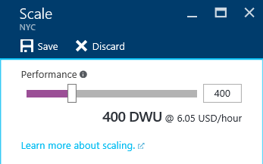
Introducing Data Warehouse Units
CPU
DWU
DW100
DW200
DW300
DW400
DW500
DW600
DW1000
DW1200
DW1500
DW2000
DW3000
DW6000
ALTER DATABASE ContosoDW
MODIFY
(service_objective = 'DW1000'
)
;
RAM
I/O

Slide 87
Memory Management (MB per distribution)
Service admin account

Slide 88
Memory grant sizing factors
Target rows in the rowgroup
Table Overhead
#columns
#short string character typed columns
#long string character typed columns

Slide 89
Differentiating technical capabilities

Slide 90
Separate compute from storage
Control
Compute
Premium Storage
Notes:
De-coupled storage from compute & control
Completely elastic
Pay for the data you store and the compute you provision

Slide 91
Independently scale compute
SQL
Control
Compute
Premium Storage
Notes:
De-coupled storage from compute & control
Completely elastic
Pay for the data you store and the compute you provision

Slide 92
Pause and resume workload
SQL
Control
Compute
Premium Storage
Notes:
De-coupled storage from compute & control
Completely elastic
Pay for the data you store and the compute you provision

Slide 93
Supports Rowstore & Columnstore

Slide 94
Scale out = Distributed tables
ROW STORE
COLUMN STORE

Slide 95
Row & Column Store & Partition

Slide 96
Local or Geo-redundancy
Notes:
Platform as a Service (PaaS)
Leverages the cloud
Database snapshots are taken on a regular basis to support a global 8 hour RPO
A geo redundant snapshot can be used to bring online the database in any region
1 backup a day made available
Standard RA-GRS rates (per GB)
Charged for full size of the backup

Slide 97
Parallel Loading with PolyBase
Compute Node
Azure Storage Blob (ASB)
DMS
Bridge
Control Node
Compute Node
DMS
DMS
Bridge
Compute Node
DMS
Bridge

Slide 98
Azure SQLDW Take-aways
No CAPEX
Low OPEX
Provision in just 5 minutes
Scale in seconds
Fully parallel load
Fully managed platform
Time to insight measured in minutes
Available with a one month free trial
SQL

Slide 99
Developing with Azure SQL DW

Slide 100
Row store & Column store
ROW STORE
COLUMN STORE

Slide 101
Column store taxonomy
Data
Row Group
Segments
Column store
2034857,23552534,26262569085923458958294582342-52935-2385349085295-25894-589245-285928592-5845829582-58258295849058-28592-58294582405982948529058409589584590285902859204582945825982058958290582945082905825-2502-45905-93245,vitoortkgldkggjwov j4o534585-0348565920345234059=3405943=-5923405=23950345923=509235=239560235932=46942306496046940693=46043693b069,hb05,b6905869347 87-987g89-9s8g-89-89 89-89-89mg89wer-t8t9et8-t-=8349652-=856=8=98t0e=t9e0t=e9t09=90=39560=659450693=565096=35695=69305=69,vw06=62=96069,b]si5=96292500000-2034857,23552534,26262569085923458958294582342-52935-2385349085295-25894-589245-285928592-5845829582-58258295849058-28592-58294582405982948529058409589584590285902859204582945825982058958290582945082905825-2502-45905-93245,vitoortkgldkg vlgjwov j4o534585-0348565920345234059=3405943=-5923405=23950345923=509235=239560235932=46942306496046940693=46043693b069,hb05,b6905869347 87-987g89-9s8g-89-89 89-89-89mg89wer-t8t9et8-t-=8349652-=856=8=98t0e=t9e0t=e9t09=90=39560=659450693=565096=35695=69305=69,vw06=62=96069,b]si5=96292500000-2034857,23552534,26262569085923458958294582342-52935-2385349085295-25894-589245-285928592-5845829582-58258295849058-28592-582945824059829485290584095892034857,23552534,26262569085923458958294582342-52935-2385349085295-25894-589245-285928592-5845829582-58258295849058-28592-58294582405982948529058409589584590285902859204582945825982058958290582945082905825-2502-45905-93245,vitoortkgldkggjwov j4o534585-0348565920345234059=3405943=-5923405=23950345923=509235=239560235932=46942306496046940693=46043693b069,hb05,b6905869347 87-987g89-9s8g-89-89 89-89-89mg89wer-t8t9et8-t-=8349652-=856=8=98t0e=t9e0t=e9t09=90=39560=659450693=565096=35695=69305=69,vw06=62=96069,b]si5=96292500000-2034857,23552534,26262569085923458958294582342-52935-2385349085295-25894-589245-285928592-5845829582-58258295849058-28592-58294582405982948529058409589584590285902859204582945825982058958290582945082905825-2502-45905-93245,vitoortkgldkg vlgjwov j4o534585-0348565920345234059=3405943=-5923405=23950345923=509235=239560235932=46942306496046940693=46043693b069,hb05,b6905869347 87-987g89-9s8g-89-89 89-89-89mg89wer-t8t9et8-t-=8349652-=856=8=98t0e=t9e0t=e9t09=90=39560=659450693=565096=35695=69305=69,vw06=62=96069,b]si5=96292500000-2034857,23552534,26262569085923458958294582342-52935-2385349085295-25894-589245-285928592-5845829582-58258295849058-28592-58294582405982948529058409589
2034857,23552534,26262569085923458958294582342-52935-2385349085295-25894-589245-285928592-5845829582-58258295849058-28592-58294582405982948529058409589584590285902859204582945825982058958290582945082905825-2502-45905-93245,vitoortkgldkggjwov j4o534585-0348565920345234059=3405943=-5923405=23950345923=509235=239560235932=46942306496046940693=46043693b069,hb05,b6905869347 87-987g89-9s8g-89-89 89-89-89mg89wer-t8t9et8-t-=8349652-=856=8=98t0e=t9e0t=e9t09=90=39560=659450693=565096=35695=69305=69,vw06=62=96069,b]si5=96292500000-2034857,23552534,26262569085923458958294582342-52935-2385349085295-25894-589245-285928592-5845829582-58258295849058-28592-58294582405982948529058409589584590285902859204582945825982058958290582945082905825-2502-45905-93245,vitoortkgldkg vlgjwov j4o534585-0348565920345234059=3405943=-5923405=23950345923=509235=239560235932=46942306496046940693=46043693b069,hb05,b6905869347 87-987g89-9s8g-89-89 89-89-89mg89wer-t8t9et8-t-=8349652-=856=8=98t0e=t9e0t=e9t09=90=39560=659450693=565096=35695=69305=69,vw06=62=96069,b]si5=96292500000-2034857,23552534,26262569085923458958294582342-52935-2385349085295-25894-589245-285928592-5845829582-58258295849058-28592-582945824059829485290584095892034857,23552534,26262569085923458958294
2034857,23552534,26262569085923458958294582342-52935-2385349085295-25894-589245-285928592-5845829582-58258295849058-28592-58294582405982948529058409589584590285902859204582945825982058958290582945082905825-2502-45905-93245,vitoortkgldkggjwov j4o534585-0348565920345234059=3405943=-5923405=23950345923=509235=239560235932=46942306496046940693=46043693b069,hb05,b6905869347 87-987g89-9s8g-89-89 89-89-89mg89wer-t8t9et8-t-=8349652-=856=8=98t0e=t9e0t=e9t09=90=39560=659450693=565096=35695=69305=69,vw06=62=96069,b]si5=96292500000-2034857,23552534,26262569085923458958294582342-52935-2385349085295-25894-589245-285928592-5845829582-58258295849058-28592-58294582405982948529058409589584590285902859204582945825982058958290582945082905825-2502-45905-93245,vitoortkgldkg vlgjwov j4o534585-0348565920345234059=3405943=-5923405=23950345923=509235=239560235932=46942306496046940693=46043693b069,hb05,b6905869347 87-987g89-9s8g-89-89 89-89-89mg89wer-t8t9et8-t-=8349652-=856=8=98t0e=t9e0t=e9t09=90=39560=659450693=565096=35695=69305=69,vw06=62=96069,b]si5=96292500000-2034857,23552534,26262569085923458958294582342-52935-2385349085295-25894-589245-285928592-5845829582-58258295849058-28592-582945824059829485290584095892034857,23552534,26262569085923458958294
Notes:
These are partition aligned rowgroups. If you have a partition, you will get a rowgroup per partition.
If the partitions are too small, then you won’t have very many rowgroups in each partition and performance will slow.

Slide 102
Scale out = Distributed tables
ROW STORE
COLUMN STORE

Slide 103
Creating tables
CREATE TABLE [dbo].[DimStore]
(
[StoreKey] int NOT NULL
, [GeographyKey] int NOT NULL
, [StoreName] nvarchar(100) NOT NULL
, [StoreType] nvarchar(15) NULL
, [StoreDescription] nvarchar(300) NOT NULL
, [Status] nvarchar(20) NOT NULL
, [OpenDate] datetime NOT NULL
, [CloseDate] datetime NULL
, [ETLLoadID] int NULL
, [LoadDate] datetime NULL
, [UpdateDate] datetime NULL
)
WITH
( CLUSTERED INDEX([StoreKey])
, DISTRIBUTION = ROUND_ROBIN
)
;
CREATE TABLE [dbo].[FactOnlineSales]
(
[OnlineSalesKey] int NOT NULL
, [DateKey] datetime NOT NULL
, [StoreKey] int NOT NULL
, [ProductKey] int NOT NULL
, [PromotionKey] int NOT NULL
, [CurrencyKey] int NOT NULL
, [CustomerKey] int NOT NULL
, [SalesOrderNumber] nvarchar(20) NOT NULL
, [SalesOrderLineNumber] int NULL
, [SalesQuantity] int NOT NULL
, [SalesAmount] money NOT NULL
)
WITH
( CLUSTERED COLUMNSTORE INDEX
, DISTRIBUTION = HASH([ProductKey])
)
;
Row
Column
Distribution

Slide 104
Guidance: Table Design
Row store: small tables & dimensions
<60 million rows
Round Robin most tables
Exception: shared hash distribution key is available in dimension
Column store: fact tables
Hash distribute table (ideally)
Column contains static values
Column does not contain NULL values
Large number of distinct values (600+)
Even distribution of rows across the distinct values

Slide 105
Joining distributed tables: round robin to hash
DimProduct ROUND_ROBIN
Store_Sales HASH([ProductKey])
Notes:
JOIN is on the TYPE
Must also be an equi-join

Slide 106
Joining distributed tables: round robin to hash
DimProduct ROUND_ROBIN
[ProductKey] INT NULL
Store_Sales HASH([ProductKey])
[ProductKey] INT NULL

Slide 107
Joining distributed tables: hash to hash
Store_Sales HASH([ProductKey])
Web_Sales HASH([ProductKey])
Notes:
JOIN is on the TYPE
Must also be an equi-join

Slide 108
Joining distributed tables: hash to hash
Store_Sales HASH([ProductKey])
[ProductKey] INT NULL
Web_Sales HASH([ProductKey])
[ProductKey] INT NULL

Slide 109
Joining distributed tables: incompatible hash
Store_Sales HASH([ProductKey])
[ProductKey] INT NULL
Web_Sales HASH([ProductKey])
[ProductKey] BIGINT NULL

Slide 110
Guidance: hash and joins
Hash distributed columns
Identify columns used frequently in joins and group by aggregations
Avoid columns used in the where clause
Join compatibility
Shared distribution key
Must be an equi-join (=)
Distribution keys must have the same data type
Aggregation compatibility
Compatible = distribution key in group by clause
Incompatible = no group by clause or distribution key not present

Slide 111
Row & Column Store & Partition

Slide 112
Guidance: Partitioning
Don’t over partition
Partitioning granularity likely to differ to SQL Server
Data is already spread across 60 distributions
Columnstore index row groups up to 1,048,576 rows
Partition for data management
Sliding window development
Targeted index rebuilds

Slide 113
Migration

Slide 114


Challenges of a Conventional Cloud Migration
Conventional rip-and-replace requires modification or refactoring of all applications
Time-consuming
High risk
Massive disruption to the business
Inaccurate results
Old Stack
New Stack
DIFFICULT
App (orig.)
Application Migration
(3 – 5 years)
App (mod*.)
EASY
Old DB
Data & Schema
Migration
(1 – 3 months)
New DB
Cloud DB
*Application needs to be modified during a conventional migration

Slide 115

Datometry Enabled Cloud-Shift to Azure SQL DW
Hyper Q - Cross Translator Technology
Fully transparent to applications
Lets Teradata applications run natively on Azure SQL DW
Translates SQL Language and Teradata protocol
Benefits
Replace Teradata with cost effective Azure SQL DW for most workloads
Eliminate risk associated with conventional migration
Best of both worlds – Teradata applications and Microsoft applications on the same stack
Teradata Re-Platforming Scenario
Teradata Clients
Reporting/BI
Analytics
ETL/ELT
Teradata ODBC/JDBC/
CLIv2 Connectors
Datometry
Hyper-Q
+
Azure SQL DW
Note: Oracle to Azure SQL DW coming November 2016
Notes:
Datometry Hyper-Q intercepts communication of original application on the network
Converts statements and data on-the-fly
Operates completely transparent to application and database
Optimizes for new target database
Adds no measurable latency overhead
Positively changes the economics of a cloud-shift and eliminates the need for an application migration

Slide 116


Use Case: Teradata Queries – Microsoft Global Account
In Numbers
17,364 Queries
4,359 GB Ordinal
9,449 Cast
500 Keywords
Locking Hint
Complexities
“Locking” on all queries
None run on ADW natively
New Stack
App (orig.)
Datometry
Hyper-Q
ADW does not support Teradata proprietary extensions to the SQL language today

Slide 117
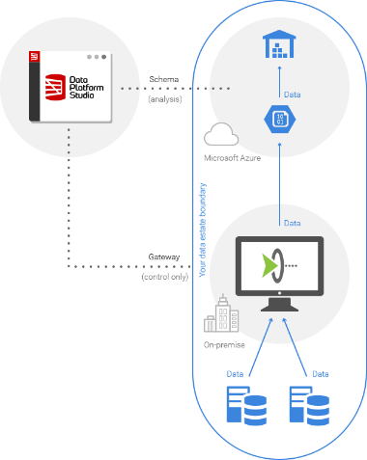
Data Platform Studio: SQL Server>SQLDW
www.dataplatformstudio.com
Automated migration from SQL Server to SQL Data Warehouse
Parallelized extraction, upload and ingestion
Opinionated data and schema compatibility
Data never leaves the user’s estate
Free to use for one-off migrations

Slide 118
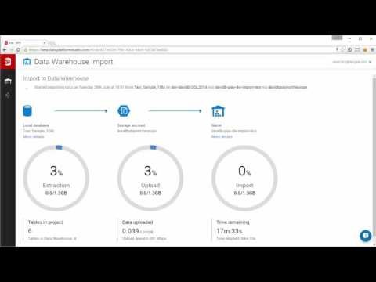
Data Platform Studio Video

Slide 119
Partner Ecosystem

Slide 120
















Current Azure SQL Data Warehouse partners
Business Intelligence / Analytics
Data Integration
Data Management
Tools

Slide 121

























































Cortana partners
System Integrators and Consulting Services
ISVs and Cloud App/Service Providers

Slide 122
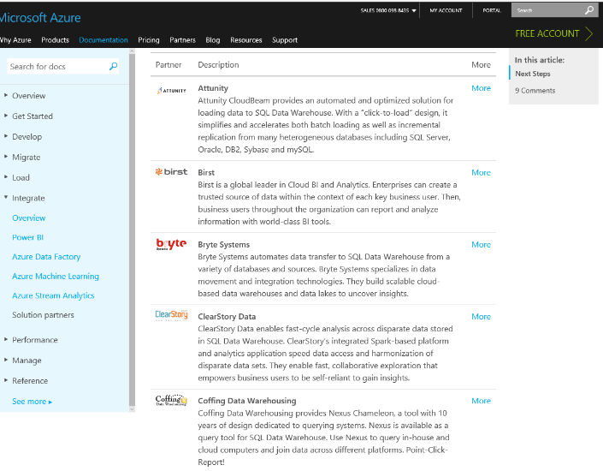
Partner listings

Slide 123
Resources \ CTA

Slide 124
Free trial
One month free trial
Up to 1000 DWU
No restriction on usage during trial
Trial ends June 30th 2017
http://azure.com/sqldwfreetrial

Slide 125
Online resources
ACOM
http://aka.ms/sql-dw-docs
Feedback
http://aka.ms/sql-dw-feedback
MSDN
http://aka.ms/msdn-t-sql
Stack overflow
http://stackoverflow.com/questions/tagged/azure-sqldw
Video: A developers guide to Azure SQL Data Warehouse
http://aka.ms/build-sql-dw-developers-guide
Video: Building Analytics for the Modern Business
http://aka.ms/build-sql-dw-analytics-modern-biz
Video: Fraud analysis using SQL DW & SQL Server 2016 Reporting Services
http://aka.ms/video-sql-dw-fraud-analysis
Ramp up

